Slide 1
INVESTMENT CASE STUDY SUBMISSION
SUBMITTED BY:
Rajesh Kumar Mishra

Slide 2
OBJECTIVE
Is to find the best sectors, countries, and a suitable investment type for Spark fund to make investments.

Slide 3
Problem Solving flow
Reading the data with proper encoding
Merged the data from both the table after converting the column value in lower case
Used group by and calculated the avg for venture, seed, angel and private equity type funding
Found top 9 countries based on amount of investment
Capture all the data for the funding type venture for further analysis
Based on the avg value of the given different fund type made a decision that venture type of funding will suite Spark fund
Separated top 3 English speaking countries
Captured each primary sector in separate column and map it to the major sector using mapping.csv
Captured top 3 major sector for each of the top 3 countries and based on that reached to my conclusion

Slide 4
Funding Type Analysis
Spark Fund want to invest between 5 to 15 million USD.
Based on the average investment value of fund type venture, seed, angel and private equity.
We can see that Venture type funding is well suited for spark fund.
Here we are taking the funding type whose average investment value meet spark fund funding criteria.
Funding type | Average Investment(In Millions)
Venture | 11.74
Seed | 0.71
Angel | 0.95
Private Equity | 73.30

Slide 5
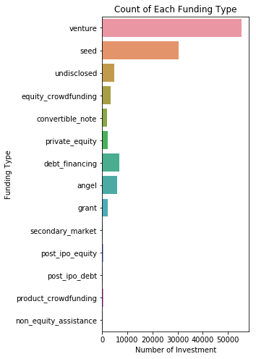
Showing the fraction of total investments (globally) for different funding round type.
From this graph we infer that most number of investment happened in venture funding type.

Slide 6
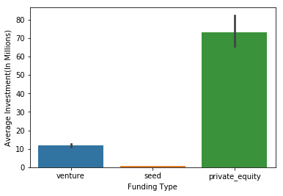
From Graph also we can see venture type funding is best suited for the spark fund

Slide 7
Country Analysis
Countries | Total amount
USA | 422510842796
CHN | 39835418773
GBR | 20245627416
IND | 14391858718
CAN | 9583332317
FRA | 7259536732
ISR | 6907514579
DEU | 6346959822
JPN | 3363676611
Spark fund wants to invest in English speaking country.
Based on the total amount investment for venture fund type in each country the top nine countries are shown in table.
Now we can see USA,GBR,IND are the top three English speaking country.
CHINA is not an English speaking country that is why ignored that.

Slide 8
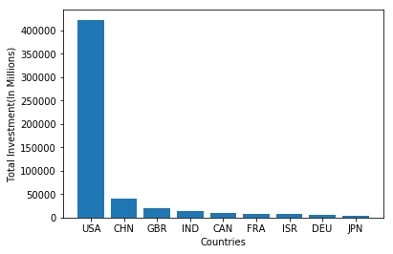
From the Graph we can see that top three countries are
USA: United States
GBR: Great Britain
IND: India

Slide 9
Sector Wise Analysis
Based on number of investment done in each major sector for top 3 English speaking country. The top 3 sector in top 3 English speaking countries are.
1 USA
1.1 Others
1.2 Social, Finance, Analytics, Advertising
1.3 Cleantech/ SemiCondutors
2 GBR
2.1 Others
2.2 Social, Finance, Analytics, Advertising
2.3 Cleantech/ SemiCondutors
3 IND
3.1 Others
3.2 Social, Finance, Analytics, Advertising
3.3 News, Search and Messaging
** This conclusion is supported by graph on next slide

Slide 10
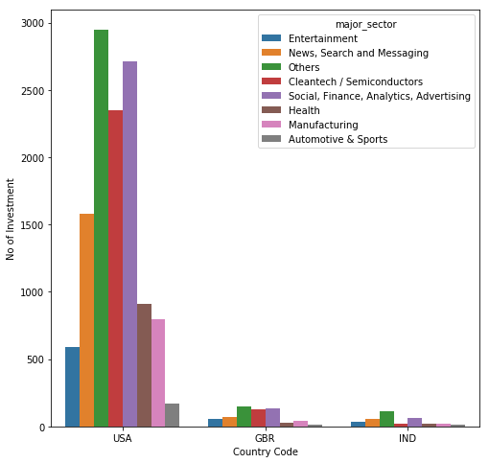
From the Graph we can see that top 3 sectors for each country are
1 USA
1.1 Others
1.2 Social, Finance, Analytics, Advertising
1.3 Cleantech/ SemiCondutors
2 GBR
2.1 Others
2.2 Social, Finance, Analytics, Advertising
2.3 Cleantech/ SemiCondutors
3 IND
3.1 Others
3.2 Social, Finance, Analytics, Advertising
3.3 News, Search and Messaging

Slide 11
Conclusion
By doing all the analysis and keeping the spark fund investment criteria in mind
Best countries to invest in | USA
Best Sector to invest in | Others
Best Funding type to invest | Venture

